Slide 1
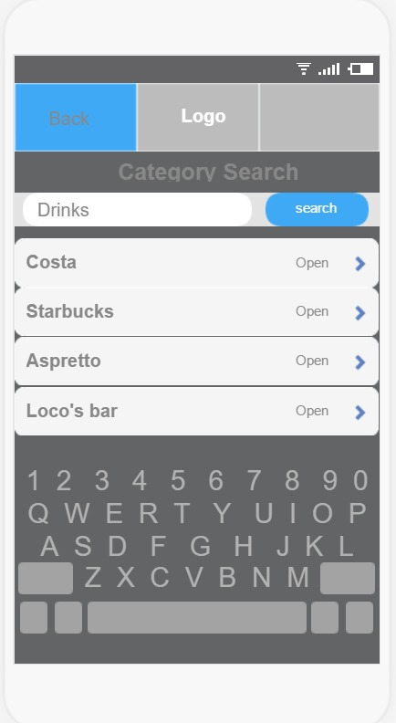
Category search screen
When a user clicks on “Category Search” from the main menu a drop down menu appears with 10 common categories.
A user also can search for categories instead choosing from the drop down.
After the user chooses a category (drinks) then the app shows the shops from where drinks can be purchased.
If “Back” is clicked it takes to the previous menu

Slide 2

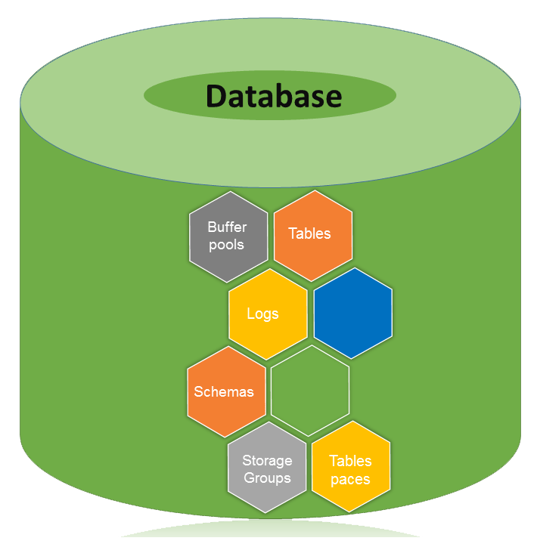
USE case
Search for categories
include
include
Main Menu
include
Category Search
include
include
10 common categories
extends
Shop/Menu
extends
extends
extends
Share
Location
extends
Social Network
Google Maps

